Slide 1


Visual Aids for Presentation Technical Writing and Presentation
TRƯỜNG ĐẠI HỌC BÁCH KHOA HÀ NỘI
HANOI UNIVERSITY OF SCIENCE AND TECHNOLOGY
SOICT - 2020

Slide 2
Contents
Aims of visual aids
Types of visual aids
Tips for designing slides with visual aids
Tips for using visual aids

Slide 3
Why use visual aids in presentations?
PEOPLE REMEMBER
10% of what they read
20% of what they hear
30% of what they see
70% of what they see & hear

Slide 4
Why use visual aids in presentations?
Makes presentation more interesting and lively
Helps audience understand the presentation
Helps speaker present information more systematically
Reinforce and add impact to information

Slide 5
Why use visual aids in presentations?
Illustrate a relationship between ideas
Show information patterns or pictures
Present figures, graphs or charts
Summarize key points
Help audience follow passages or quotations

Slide 6
Choice of visual aids depends on
The resources at your disposal
Cost
Time available for preparation
Size of group
Your own and preferences of others
The learning environment

Slide 7
Types of visual aids used in Presentation
Handouts
Posters
White/black boards
Video clip
PowerPoint Slides
Flipcharts
Transparencies

Slide 8
Handouts
Why use handouts?
Audience can concentrate better (instead of writing)
Provide more detailed information
Summarizing or including the main points of a presentation (take away message)
Useful if your presentation is highly technical or complex
When to provide handouts?
Before or after presentation?
What to include in your handout?
Expand on bullet points and graphics to allow a more complete explanation. Just don't go overboard
May include related information that further supports or explains what is in your presentation

Slide 9

Posters
Used at the precise moment to illustrate point
Visible throughout presentation
Consider how it should be displayed
May need a pointer

Slide 10
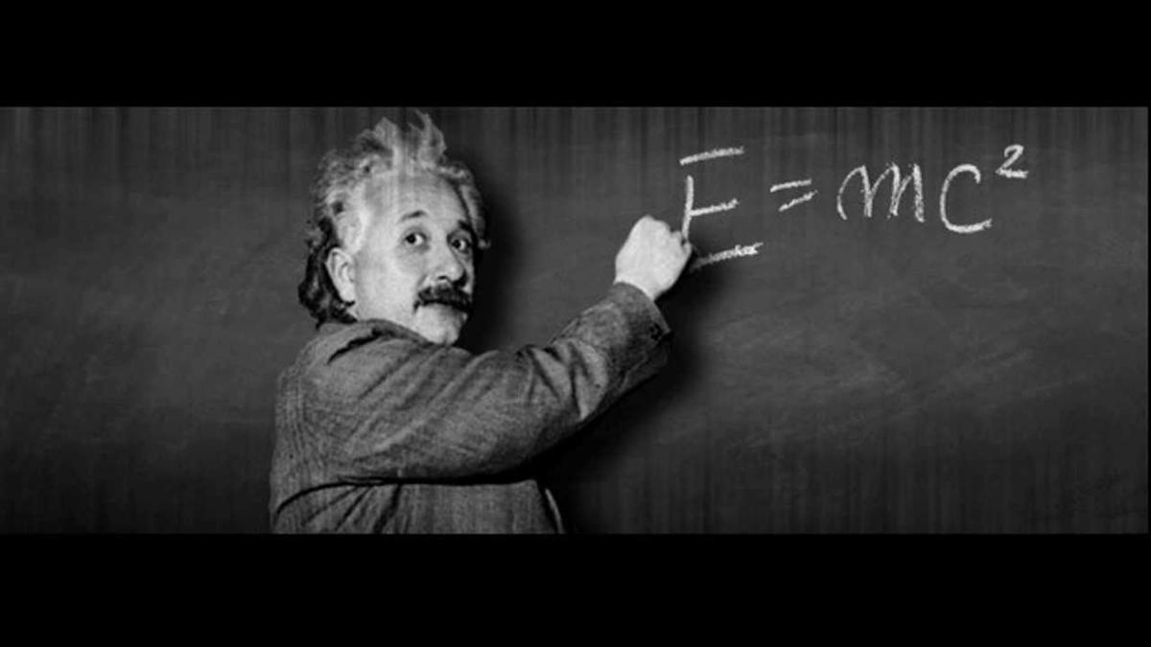
White/black boards
Flexible and interactive
Suits small group
Writing clearly can be slow
Back to the audience
Can’t store information
Can scratch & squeal
Need chalk & duster
Easy to use & wipe
Notes:
Can scratch & squeal: có thể bị xước và tạo tiếng két

Slide 11
White/black boards
Clean the board well before starting and check the condition of marker
Write large letters
Stand to side as write
Don’t face the board while talking to audience
Divide the board into column and legibly
Keep contents which you may want to refer to again

Slide 12
Video clip
Can show clips of specific examples discussed
Add another dimension to presentation
Possible technical problem

Slide 13
PowerPoint Slides
Can look very professional
Very good for building up slides, diagrams
Introduce text a line at a time (wipe, dissolve)
Easy to update old presentations
Can use same slide many times
Colour and multimedia

Slide 14
PowerPoint Slides
Suits groups of various sizes
Hard to keep audience attentive
Technical problems
Lighting issues
Check the computer system/equipment before loading
Familiarize with the operation of the slides
Transfer presentation to hard disk
Be familiar with the operation of slide show
Rehearse presentation
Keep a printed copy of slides in case of computer malfunction

Slide 15
One idea per slide
What idea does this illustrate?
Does it support my key message?
Avoid using too much text

Slide 16
Diagrams
Colour can be very useful for diagrams
Use several diagrams for complex models
Relevant parts only
Build up diagrams
Hi-light and masking
Simple schematics tend to be most effective

Slide 17
Example: Diagram of User input and solution in a car parking recommender system
Customer
input
Configuration (Part of CSP solution)
Functions
GSM-radio
C_{g,f}
free-com
biz-pack = y
C_{b,g}
{y, n}
{y,n }
biz-pack
YES
YES
{y, n}
y
y
C_{b,r,s}
sensor
n
{y, n}
n
NO
C_{v,s,e}
easy-parking
y
{y, n}
rec-pack
C_{r,v}
video
{y, n}
{y, n}
YES
rec-pack = y
YES

Slide 18
Tables
Usually have too much information
Too many numbers
Graph or a pictorial representation
Equations – don’t include unless you intend to explain them
Inferential statistics – don’t include unless directly relevant to your message
Notes:
Inferential statistics: Thống kê suy luận

Slide 19
Example in a Recommender System: Explaining solutions (1)
The typical approach used to answer a why-question is to compare the presented case with the customer requirements and to highlight which constraints are fulfilled and which are not (McSherry 2003b)
Example:
id | price | mpix | Opt-zoom | LCD-size | movies | sound | waterproof
p1 | 148 | 8.0 | 4x | 2.5 | no | no | yes
p2 | 182 | 8.0 | 5x | 2.7 | yes | yes | no
p3 | 189 | 8.0 | 10x | 2.5 | yes | yes | no
p4 | 196 | 10.0 | 12x | 2.7 | yes | no | yes
p5 | 151 | 7.1 | 3x | 3.0 | yes | yes | no
p6 | 199 | 9.0 | 3x | 3.0 | yes | yes | no
p7 | 259 | 10.0 | 3x | 3.0 | yes | yes | no
p8 | 278 | 9.1 | 10x | 3.0 | yes | yes | yes
Notes:
Phân tích các ví dụ v

Slide 20
Explaining solutions (2)
If a customer is interested in digital cameras with a price less than 150, then p1 is recommended.
id | price | mpix | Opt-zoom | LCD-size | movies | sound | waterproof
p1 | 148 | 8.0 | 4x | 2.5 | no | no | yes
p2 | 182 | 8.0 | 5x | 2.7 | yes | yes | no
p3 | 189 | 8.0 | 10x | 2.5 | yes | yes | no
p4 | 196 | 10.0 | 12x | 2.7 | yes | no | yes
p5 | 151 | 7.1 | 3x | 3.0 | yes | yes | no
p6 | 199 | 9.0 | 3x | 3.0 | yes | yes | no
p7 | 259 | 10.0 | 3x | 3.0 | yes | yes | no
p8 | 278 | 9.1 | 10x | 3.0 | yes | yes | yes
Why?

Slide 21
Explaining solutions (3)
The weights of the attributes can be incorporated into the answers
If the customer requires a price less than 160 and LCD size of more than 2.4 inches, where LCD size is weighted much more than price, then p5 is recommended
id | price | mpix | Opt-zoom | LCD-size | movies | sound | waterproof
p1 | 148 | 8.0 | 4x | 2.5 | no | no | yes
p2 | 182 | 8.0 | 5x | 2.7 | yes | yes | no
p3 | 189 | 8.0 | 10x | 2.5 | yes | yes | no
p4 | 196 | 10.0 | 12x | 2.7 | yes | no | yes
p5 | 151 | 7.1 | 3x | 3.0 | yes | yes | no
p6 | 199 | 9.0 | 3x | 3.0 | yes | yes | no
p7 | 259 | 10.0 | 3x | 3.0 | yes | yes | no
p8 | 278 | 9.1 | 10x | 3.0 | yes | yes | yes
Why?

Slide 22
Explaining solutions (4)
The requirements of a customer might be too specific
Why-explanations provide information about the violated constraints
For example, if the customer requires a price less than 150 and a movie function, then no product fulfills these requirements.
id | price | mpix | Opt-zoom | LCD-size | movies | sound | waterproof
p1 | 148 | 8.0 | 4x | 2.5 | no | no | yes
p2 | 182 | 8.0 | 5x | 2.7 | yes | yes | no
p3 | 189 | 8.0 | 10x | 2.5 | yes | yes | no
p4 | 196 | 10.0 | 12x | 2.7 | yes | no | yes
p5 | 151 | 7.1 | 3x | 3.0 | yes | yes | no
p6 | 199 | 9.0 | 3x | 3.0 | yes | yes | no
p7 | 259 | 10.0 | 3x | 3.0 | yes | yes | no
p8 | 278 | 9.1 | 10x | 3.0 | yes | yes | yes
Most similar
products

Slide 23
Graphs
Title, axis marks, legend, labels
Pie charts – not unless data sum to 100%
Three dimensional charts
Good contrast
Colour (5 max)
Lines 4 times thicker than for printed work
Error bars
Simple schematic

Slide 24
Example: Chart with Precision and Recall
E.g. typically when a recommender system is tuned to increase precision, recall decreases as a result (or vice versa)

Slide 25
Tips for designing visual aids
COLOUR
- clear & appropriate
- one color for main idea, two complementary color for sub points.
- avoid red-green and pastels
LAYOUT and SPACE
Notes:
Pastels: phấn màu

Slide 26
Tips for designing visual aids
STYLE - Select one style and use consistently
TeXt STYLE AND SIZE - Choose carefully

Slide 27
Tips for designing visual aids
AVOID GIMMICKS - Computer graphics (background, patterns, clip art etc.) should be used to enhance presentation.
PROOFREAD
PLAN AHEAD
Notes:
GIMMICKS: mánh lới

Slide 28
Tips for using visual aids
INTEGRATE visual aids
REHEARSE with your visual aids
Maintain EYE CONTACT
DO NOT READ from your visual aid
STOP SPEAKING while audience read

Slide 29
Tips for using visual aids
DO NOT PASS OUT items while presenting
REVEAL AIDS only when NEEDED
USE THEM, don’t just display them!
CHECK ROOM & EQUIPMENT in
advance
CHECK visual is VISIBLE to audience

